Slide 1
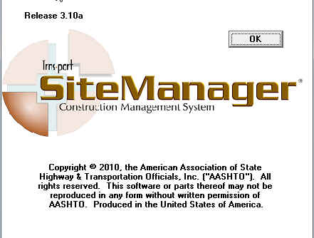

ProjectWise and Sitemanager
Matt Looney, PE
KYTC Construction
Matt.Looney@ky.gov (Yes, I know these are very dry topics)

Slide 2

New Template as of December 2013
77 folders down to 34 folders
All Construction Personnel can Add/Delete/Rename folders as they see fit. (But please use similar folder names and locations if adding/renaming folders)

Slide 3
New Guidance Documents in ProjectWise
  KYTC-Main\Documents\Central Office\Construction\ProjectWise Info\Folder Structure and Guidance
  Also included as hard copy in New SE Reference Guides (available at this meeting!)

Slide 4
Proper Naming is Critical
  Be sure to always name documents so they can be identified by name without a user having to open the document.
  Always include:
  Contract ID
  Type of Document (Final Inspection, Formal Acceptance, Completion Notice, etc.)
  Date of Document if Applicable

Slide 5
File Name Examples
121302FinalInspectionReport.pdf
121302Formal AcceptanceReport.pdf
121302Pier2damage20130902.jpg

Slide 6

SiteManager

Slide 7
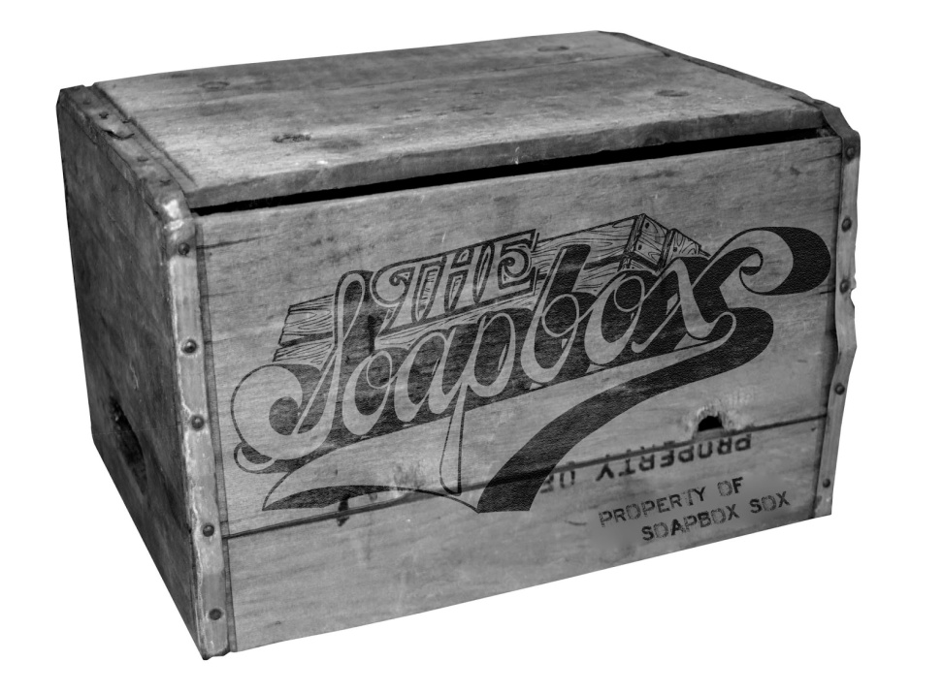
Still Important to do……
Enter Key Dates in a timely manner
Send Reports Generated in SiteManager.
  Work Complete Notice
  Corrective Work Complete Notice

Slide 8
SiteManager 3.10a
Soon to be a thing of the Past!!
(maybe)

Slide 9
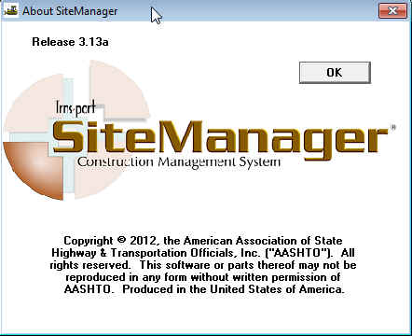
SiteManager 3.13a
HELLO FUTURE!!

Slide 10
SiteManager 3.13a
Not too much has changed for the user from version 3.10a.
- Change Order Screens now have tab navigation

Slide 11
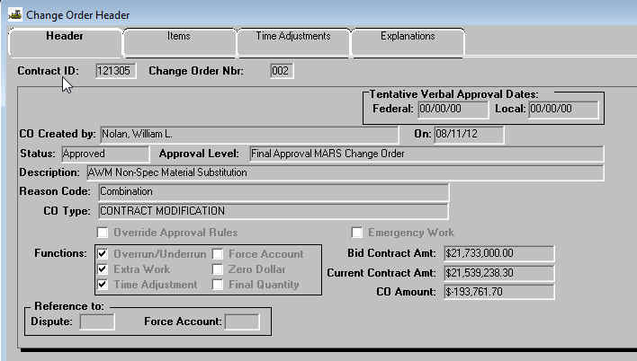

Slide 12
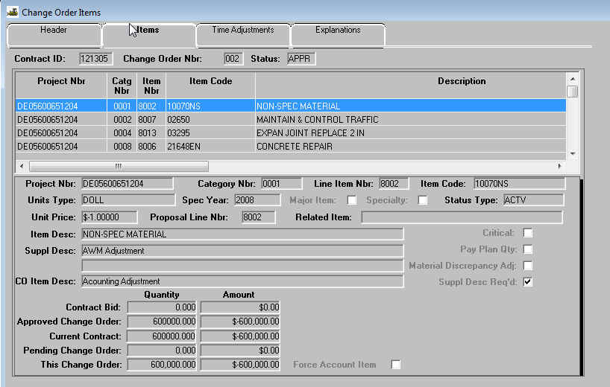

Slide 13
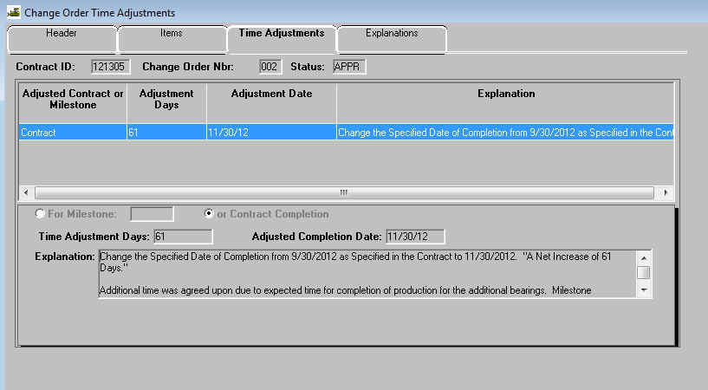

Slide 14
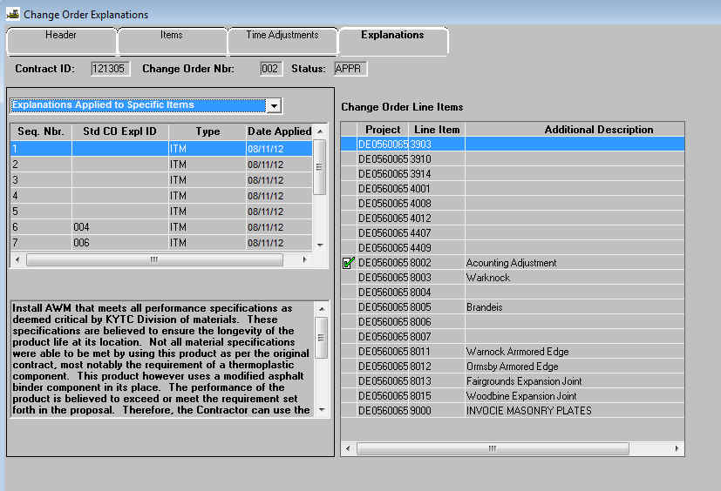

Slide 15
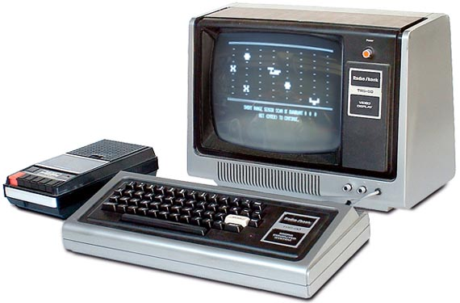
….And then what?

Slide 16
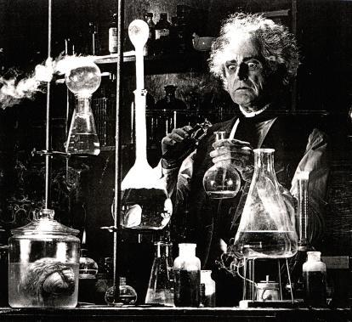
Currently beginning Beta testing phases for:
Sitemanager 3.15a
And then…….

Slide 17

AASHTOWare Project 3.0
Web based system – extension of PreConstruction program already in use by KYTC.
2016?

Slide 18

QUESTIONS?
- I can’t make your local network connection faster.
I can’t get you cell phone service that works.
I can’t get you better trucks, more people, or increments.
Anything else is fair game.

Slide 19


Contact Info:
Matt.Looney@ky.gov
(502) 564-4780 – Office

